Slide 1
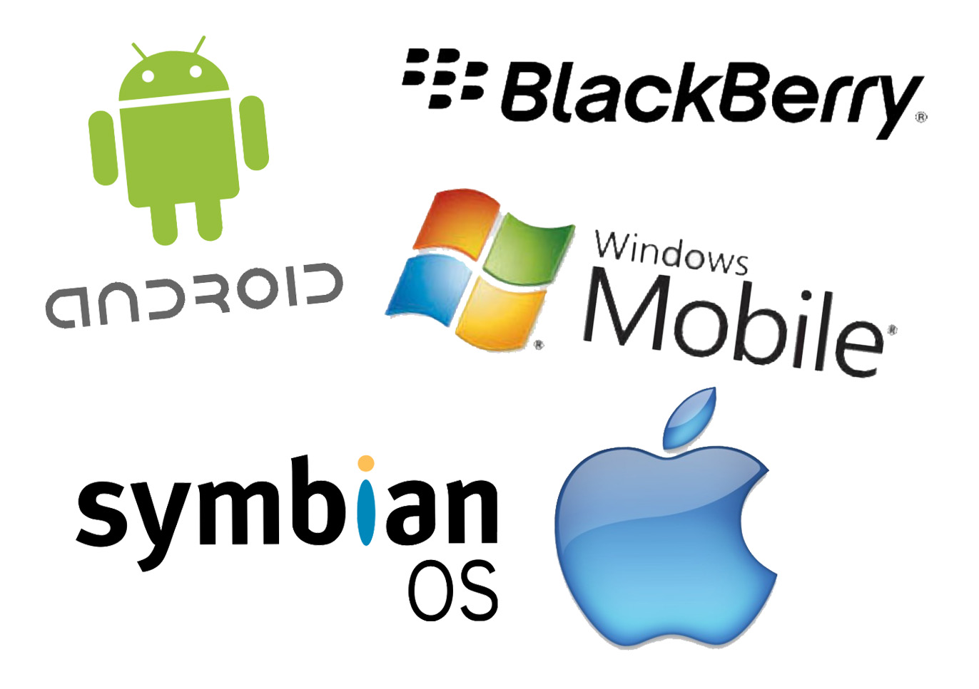
Mobile Technologies from the past, present and future
David Forster
City of Bath College
Notes:
Image from: https://itkey.media/wp-content/uploads/2015/02/Smartphone-OS.jpg

Slide 2
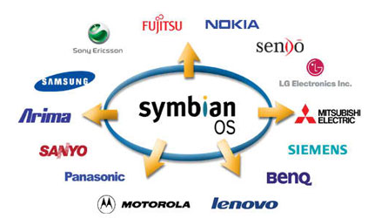
Symbian OS
Notes:
The Symbian operating system for mobile phones was the most popular smartphone operating system and was used by most mobile phone brands such as Nokia, Motorola and Samsung. However, due to the rise of Android OS, Symbian became less popular and its market share began to decline. Nokia was the last smartphone company to continue to support Symbian OS, in 2010 Nokia replaced Symbian OS with Windows OS for their smartphones.
Information from: https://en.wikipedia.org/wiki/Symbian
Image from: http://symbianos.org/wp-content/uploads/2014/10/feature-2.jpg

Slide 3
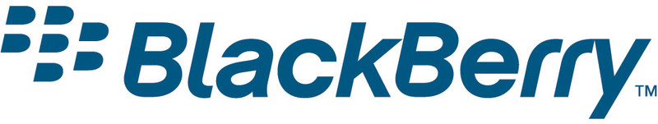
Blackberry OS
Notes:
Blackberry is a smartphone operating system similar to IOS in the sense that the operating system is used on its own products made by Blackberry. However, Blackberry’s market share has declined heavily in recent years unlike IOS which is still the second most popular smartphone operating system of today. The Blackberry operating system was discontinued after the release of Blackberry 10 in 2013 however Blackberry will continue to support its operating system.
Information from https://en.wikipedia.org/wiki/BlackBerry_OS Image from http://media.engadget.com/img/product/17/d57/blackberry-os-5-0-rnj-800.jpg

Slide 4
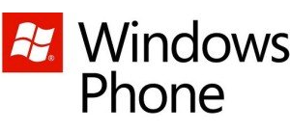
Windows IOS
Notes:
Windows phone OS is the latest upgrade to Windows Mobile which was Microsoft’s first smartphone OS which was discontinued in 2010. Windows phone does not have a high market share and currently trails behind Android and IOS and is mainly used in Nokia smartphones as Microsoft owns Nokia as of 2014 however Microsoft later admitted this acquisition of Nokia was a mistake. The first Windows phone OS version was version 7 which was released in 2010.
Image from http://i1-news.softpedia-static.com/images/news2/Microsoft-Posts-Job-Ads-for-Next-Windows-Phone-OS-Hints-to-Kinect-Integration-2.jpg
Information from https://en.wikipedia.org/wiki/Windows_Phone
Microsoft-Nokia acquisition information: http://www.computerworld.com/article/2945371/smartphones/microsoft-writes-off-76b-admits-failure-of-nokia-acquisition.html

Slide 5

Apple IOS
Notes:
Apple’s IOS was released in 2007 by Apple as their new smartphone operating system. This operating system has also been adapted to work on other Apple products such as the iPod Touch in 2007 and iPad in 2010. Since IOS’s release; it has had a steady market share close to 20% maintaining its number two spot in market shares. I think this is mainly due to Apple only allowing IOS to be used on their own products whereas Android the current leader is available on the majority of smartphones.
Information from: https://en.wikipedia.org/wiki/IOS
Image from: http://canvs.org/wp-content/uploads/2015/08/ios_logo.png

Slide 6
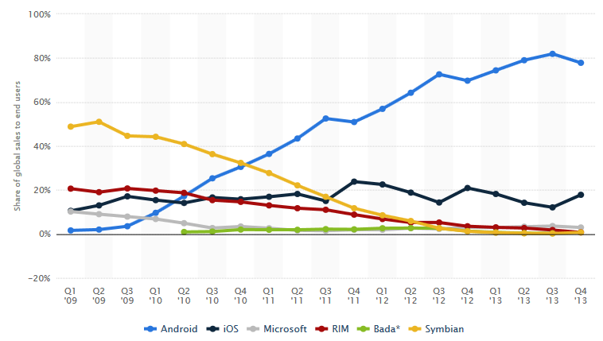
Smartphone Operating System Market Share 2009-2013
Notes:
Here we can see the past market shares from between 2009-2013. Symbian was a dominant force in the smartphone market however when Android was introduced into the market, Symbian became less and less popular until it is almost non existent in todays phones. IOS has always had a steady market share but this is most likely down to the fact that IOS is only used in Apple products whereas Android OS is used in multiple brands of smartphone.
Image from http://www.statista.com/statistics/266136/global-market-share-held-by-smartphone-operating-systems/

Slide 7

Android 1.5 Cupcake
Notes:
Android 1.5 Cupcake was Androids first operating system and began Androids climb to the top of the smartphone OS market share in 2008.
Image from http://media02.hongkiat.com/android-evolution/android-cupcake.jpg

Slide 8

Android 1.6 Donut
Notes:
Androids 1.6; Donut allowed users improved functionality searching the web and watching videos online.
Image from https://www.android.com/history/

Slide 9

Android 2.0 Eclair
Notes:
Android 2.0; Eclair allowed users homepage customisation allowing them to arrange apps and widgets as they would like.
Image from https://www.android.com/history/

Slide 10

Android 2.2 Froyo
Notes:
Android 2.2; Froyo allowed voice input for when the user is typing messages. This may have led to future features such as ‘Ok Google’ in the following years.
Image from https://www.android.com/history/

Slide 11
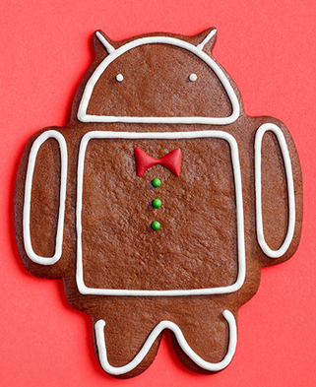
Android 2.3 Gingerbread
Notes:
Android 2.3; Gingerbread added support for sensors which improved functionality for apps that used tilting functions.
Image from https://www.android.com/history/

Slide 12

Android 3.0 Honeycomb
Notes:
Android 3.0; Honeycomb added tablet support due to the rise of tablets in recent years. This was because the previous versions of Android would not suit the screen resolutions needed by tablets due to their increased screen size compared to smartphones.
Image from https://www.android.com/history/

Slide 13
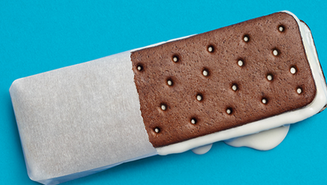
Android 4.0 Ice Cream Sandwich
Notes:
Android 4.0; Ice Cream included a refined design, 1080p HD camera support and photo editor. This may have been as a result of social media use with websites such as Instagram gaining popularity.
Image from https://www.android.com/history/

Slide 14

Android 4.1 Jelly Bean
Notes:
Android 4.1; Jelly Bean included ‘Google Now’, and improved Bluetooth support with smart devices such as smartphones and tablets.
Image from https://www.android.com/history/

Slide 15
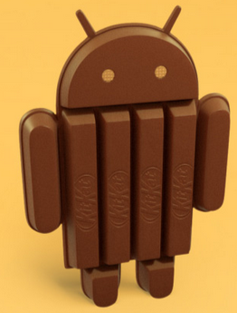
Android 4.4 KitKat
Notes:
Android 4.4; KitKat featured improved design and performance, and introduced ‘Ok Google’ which involves users speaking to their smart device and telling the device what to do by giving voice commands.
Image from https://www.android.com/history/

Slide 16

Android 5.0 Lollipop
Notes:
Android 5.0; Lollipop added support for bigger screens such as smart televisions and smaller screens such as screens users can use to watch television in their cars.
Image from https://www.android.com/history/

Slide 17
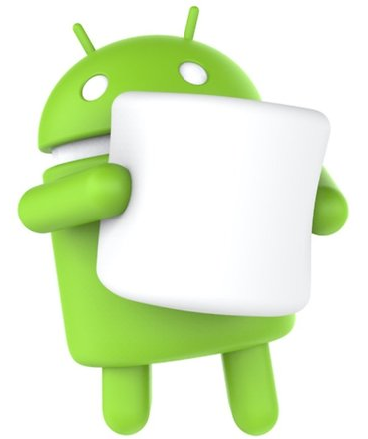
Android 6.0 Marshmallow
Notes:
Android 6.0; Marshmallow includes ‘Google Now Tap’ which allows users to tap the screen and allow Google to make a search based on what is currently on your screen providing you with more information.
Image from https://fs01.androidpit.info/userfiles/4110382/image/Android/android-6-0-marshmallow-hero-w782.jpg

Slide 18
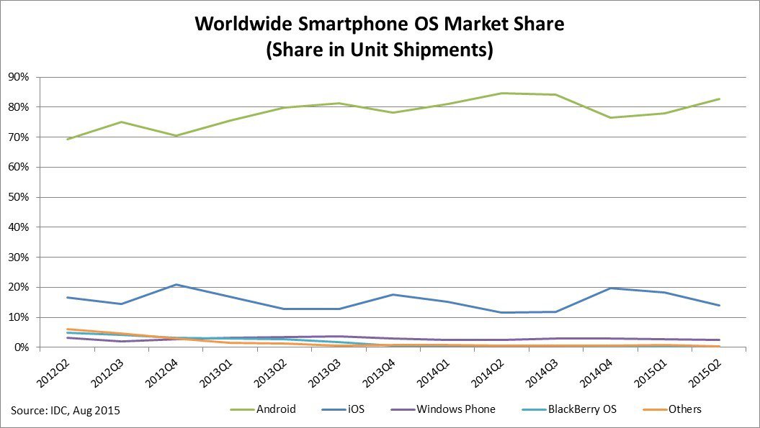
Present – Current Smartphone OS Market Share
Notes:
Currently as you can see from the graph, the Android operating system for smartphones is the most common as of quarter 2 2015. IOS by Apple has roughly 17% of the market share followed by Windows and Blackberry. Android appears to have had a slow uprising from its release between 2008-2009 but has been dominant since the decline of Symbian OS mobile phones which was the market leader before Android OS existed.
Image from http://www.idc.com/prodserv/smartphone-os-market-share.jsp

Slide 19

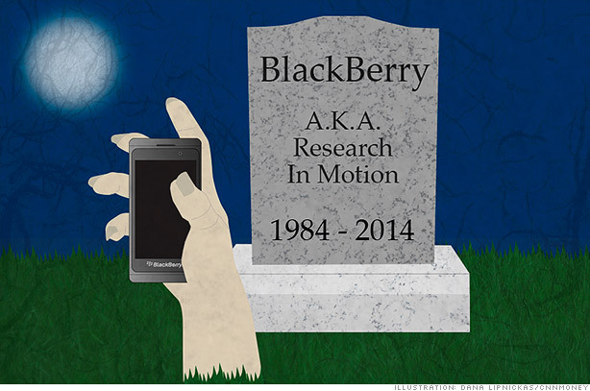
Present day smartphone OS
Notes:
In present day, these five smartphone OS’ are the most popular. Unfortunately Symbian and Blackberry OS have declined massively in the last 5 years and may cease to exist in the next few years due to discontinuations. This leaves Android and IOS having the majority market share (With Android still having much more than IOS) and Windows is in third place but not so far away from the disappearing Symbian and Blackberry OS.
Blackberry image - https://cnnmoneybuzzblog.files.wordpress.com/2013/12/blackberry-tombstone2-614xa.jpg?w=614&h=407
Symbian image - http://www.3gadget.com/filesupload%5CArticleImg%5Cart_rip-symbion.PNG

Slide 20
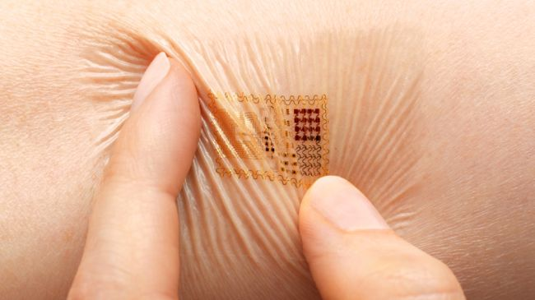
What's coming next? 1/3
Notes:
In the near future it is predicted that new payment methods will be available such as mobile payments which has already been introduced by Apple as ‘Apple Pay’. Tattoos could become a method of authentication to log into your Google mail account and pay for things.
Image from: http://cdn4.mos.techradar.futurecdn.net//art/software/Android/Android%202020/Biostamp-650-80.jpg
Information from: http://www.techradar.com/news/software/operating-systems/android-in-2020-the-future-of-google-s-mobile-os-explored-1168141/2

Slide 21
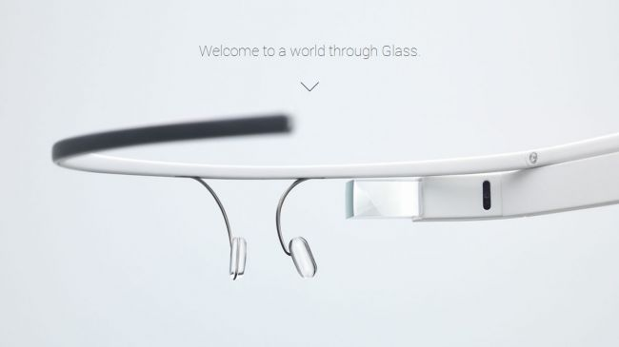
What's coming next? 2/3
Notes:
In 2020, the market could change and Androids focus could be on wearable technology such as ‘Google Glass’ rather than with smartphones. Features such as Google Now may become smarter and do many things for you automatically without any need to push buttons. It would be wise to keep track of technology such as ‘Google Glass’ because it could replace smartphones in theory if it can perform the same functions with less effort.
Information from: http://www.techradar.com/news/software/operating-systems/android-in-2020-the-future-of-google-s-mobile-os-explored-1168141/2
Image from: http://cdn1.mos.techradar.futurecdn.net//art/software/Android/Android%202020/Glass-650-80.jpg

Slide 22
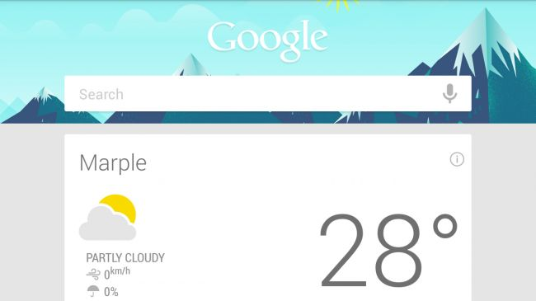
What's coming next? 3/3
Notes:
‘Google Maps’ has been a very popular feature for many years online. However, this feature could be improved to suit everyday lives of people and begin tracking each users movements and suggesting nearby locations which may appeal to the user. This may include things such as pointing out the near bar if the user visits bars often for example.
Information from: http://www.techradar.com/news/software/operating-systems/android-in-2020-the-future-of-google-s-mobile-os-explored-1168141
Image from: http://cdn1.mos.techradar.futurecdn.net//art/software/Android/Android%202020/Google%20Now-650-80.jpg

Slide 23

Any questions?
Notes:
Thank you for listening. Would you like to ask any questions regarding any of the topics I have mentioned in this presentation?

